Slide 1
AntiPatterns
Lecturer: Ngo Huy Bien
Software Engineering Department
Faculty of Information Technology
VNUHCM - University of Science
Ho Chi Minh City, Vietnam
nhbien@fit.hcmus.edu.vn

Slide 2

Objectives

Slide 3

Contents

Slide 4

References
William J. Brown et al. (1998). AntiPatterns - Refactoring Software, Architectures, and Projects in Crisis.

Slide 5
The Blob [1]
General Form
One class monopolizes the processing and other classes primarily encapsulate data.
A class diagram composed of a single complex controller class surrounded by simple data classes.
Majority of the responsibilities are allocated to a single class.

Slide 6
The Blob (cont.)
Symptoms
Single class with a large number of attributes, operations, or both.
A disparate collection of unrelated attributes and operations encapsulated in a single class.
A single controller class with associated simple, data−object classes.
The single controller class often nearly encapsulates the applications entire functionality, much like a procedural main program.

Slide 7
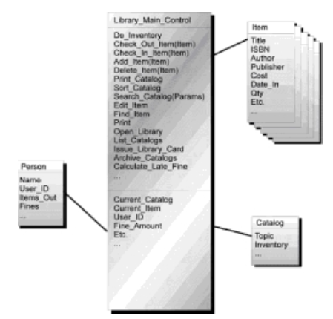
The Library Blob

Slide 8
The Blob (cont.)
Primary Causes
The designers may not have an adequate understanding of object−oriented principles.
The absence of definition of the system components, their interactions, and the specific use of the selected programming languages.
This may be the result of inadequate architectural review as development takes place.
In iterative projects, developers tend to add little pieces of functionality to existing working classes, rather than add new classes, or revise the class hierarchy for more effective allocation of responsibilities.
If the requirements dictate a procedural solution, then architectural commitments may be made during requirements analysis that are difficult to change.

Slide 9
The Blob (cont.)
Consequences
Modifications to the Blob affect the extensive software within the Blob’s encapsulation. Modifications to other objects in the system are also likely to have impact on the Blob’s software.
The Blob Class is typically too complex for reuse and testing.
The Blob Class may be expensive to load into memory, using excessive resources, even for simple operations.

Slide 10
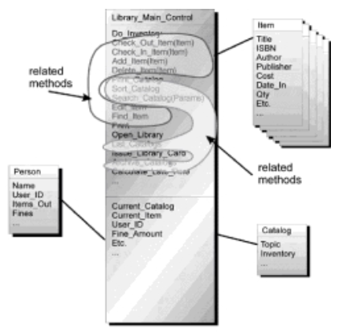
Refactored Solution Regrouping the Blob by Contracts
Identify or categorize related attributes and operations according to contracts.

Slide 11
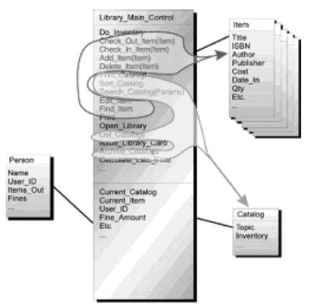
Migrating The Contracted Collections
Look for “natural homes” for these contract−based collections of functionality and then migrate them there.

Slide 12
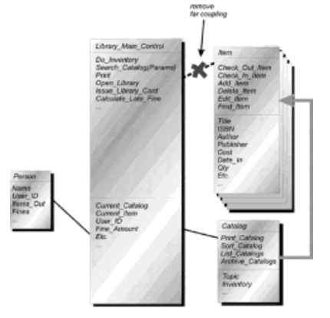
Removing The Far Couplings
Remove all “far−coupled,” or redundant, indirect associations.
Migrate associates to derived classes to a common base class.

Slide 13
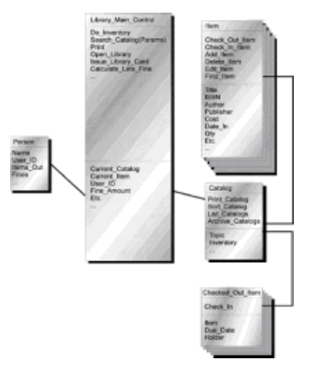
RemovingTransient Associations
Remove all transient associations, replace them as appropriate with type specifiers to attributes and operations arguments.

Slide 14
Blowhard Jamboree
In addition to technical responsibilities, developers spend too much time answering the concerns of managers and decision makers arising from controversial reports that criticize particular technologies.
An in−house expert on each key technology

Slide 15
Analysis Paralysis
Incremental development
The complexity of the analysis models results in intricate implementations, making the system difficult to develop, document, and test.
Cost of analysis exceeds expectation without a predictable end point.

Slide 16

Thank You & See You Again

